Slide 1
DSC Capstone 2
Rajesh V Subramanyam
April 2019
Springboard

Slide 2
Introduction
This project involves analysing the trends in real estate market in a populous city such as Melbourne, Australia. Although this project attempts to use the data from a real-estate website such as DOMAIN.COM.AU, this is not intended for particular organisation / entity. End goal is to predict the real estate prices based on the various factors influencing the market. This project would help an individual or an entity in making informed decisions prior to purchasing or investing in Melbourne real estate market.

Slide 3
Features & Data points
Listed below are the features of importance in the CSV file:
(1) Suburb (2) Rooms (3) Type (4) Price (Target / Dependent feature) (5) Bathroom (6) Car
(7) Landsize (8) BuildingArea (9) CouncilArea
(10) Regionname
There are nearly 35K+ Data points available in the CSV file and some of the features have NAN records.

Slide 4
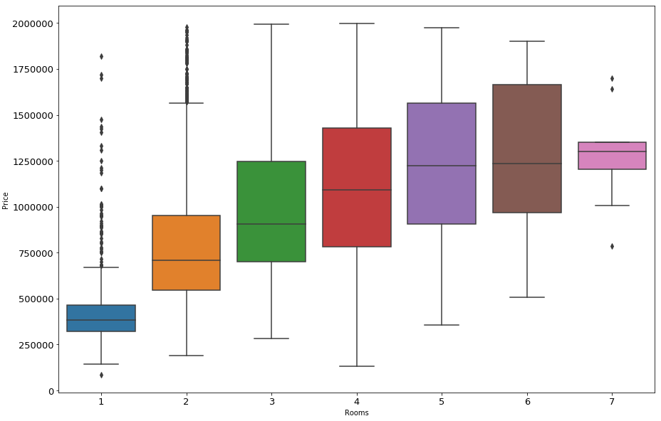
Influence of Features on Target
Number of Rooms VS Price
Feature 'Number of Rooms' varies directly with the Target “Price of the house”.
One more interesting insight is that both 5 and 6 bedroom houses are competing in the same price range

Slide 5
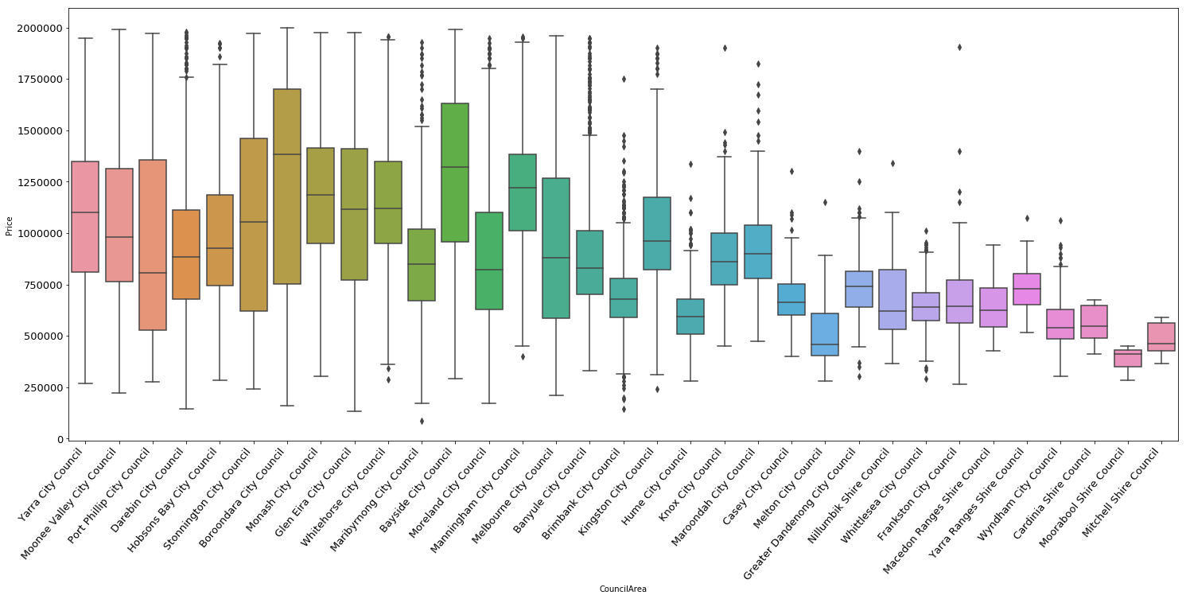
Influence of Features on Target
Council Area VS Price
Baroondara city council has the highest median price whereas Moorabook shire council has the lowest.
Both Whitehorse city and Maribrynong city council have the same price range. By removing some extreme values, we can get better insights on these features

Slide 6
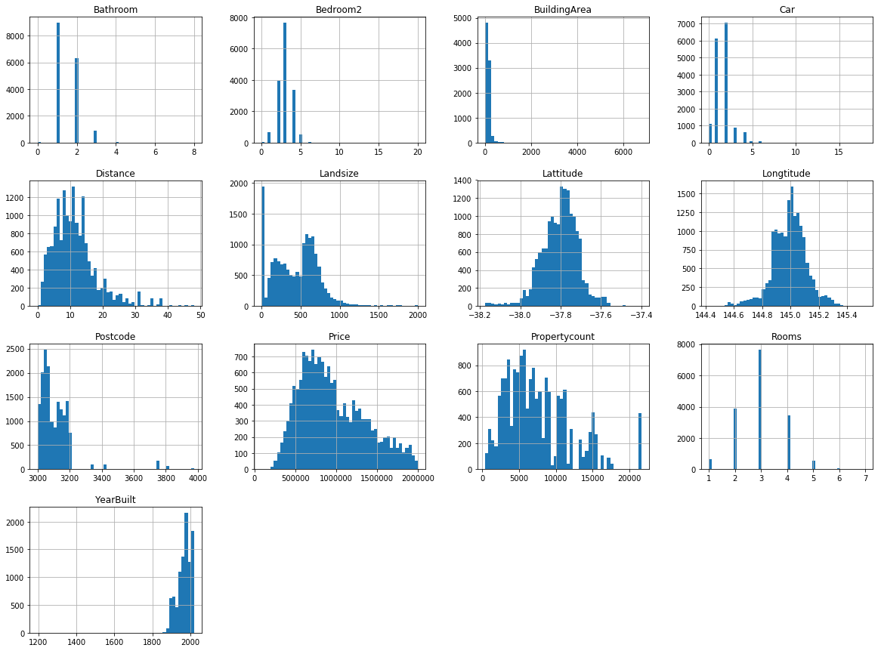
Histogram results of the Features
3 bedroom houses with the provision to park 2-3 cars are mostly preferred.
Houses nearer to the city are mostly preferred (or) Most houses are built near the city based on the results in the plot of 'Distance'
There is a preference for the land size in the range of 500 to 700 m2

Slide 7
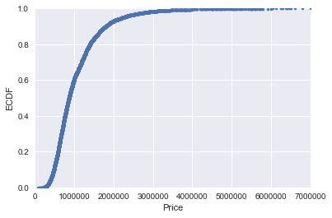
Inferential Statistics
Based on the ECDF/Price plot, we can infer that 95% of the properties have a price tag of 2 Million or more

Slide 8
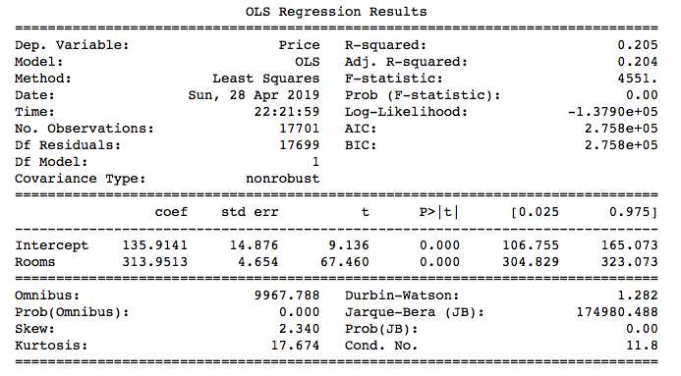
Machine Learning – Building Linear Regression Model
Using Simple Stats OLS
Based on Simple stats model Linear regression results, we ﬁnd that:
1) The coefficient of 313.95 means that as the RM variable increases by 1 i.e. predicted value of Price increases by 313.95(multiplied by 1000) i.e. 313950. So for every additional room added to the house, the house price increases by 313950
2) 95% confidence interval varies from 304.829 to 323.073 (multiply by 1000 for actual Price value).
3) The percentage of variance our model explains i.e. R-squared value i s 0.205

Slide 9
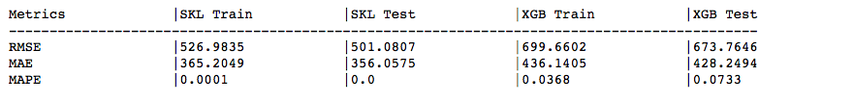
Machine Learning – Building Linear Regression Model
Using SK Learn & XGBoost
Compute Mean absolute error, Mean absolute percentage error & Root mean Squared error using sci-kit learn and XGBoost
In the above table, SKL – Scikit learn Linear regression & XGB – XGBoost. Based on the results:
1) We could notice signiﬁcant change in the metrics between SKLearn and XGBoost results.
2) Mean absolute percentage error is showing 7% of error for the XGB-test dataset. However, we had a insigniﬁcant result for SKLearn test. We can try to improve the metrics(such as RMSE) by performing KFold cross validation

Slide 10
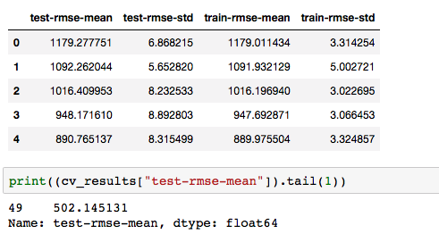
Machine Learning – Building Linear Regression Model
K Fold cross-validation using XGBoost
Based on the below observations, we ﬁnd that Test RMSE has reduced from 673.76 to 502.14. RMSE can be further improved by:
Changing the hyper-parameters
Applying techniques such as Grid search, Random search and Bayesian optimization to reach optimal set of hyper-parameters.

Slide 11
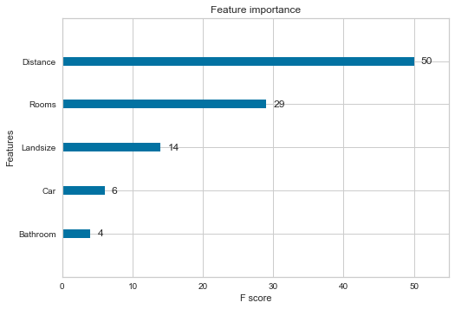
Machine Learning – Building Linear Regression Model
Importance of Features using XGBoost
Importance of features is analysed using the XGBoost algorithm. Above plot conﬁrms the fact "Distance" (a feature related to Location of the house) is much more important than any other feature in the dataset. Also, the feature "Distance" has the potential to override the importance of other features in price determination.

Slide 12
Conclusion & Client Recommendations
We had constructed Linear regression models using Simple stats OLS, SKlearn & XGBoost. Listed below are the
observations based on the results.
1) SkLearn results showed that there is a room for improving the model further. Error metrics such as 'Root Mean
Squared error', 'Mean absolute percentage error' etc proved that model is 70 - 75% accurate although there is room for
improvement
2) Although the plot for Target 'House price' distribution appears to be right skewed and not linearly distributed. This
can be corrected by taking logarthmic scale of target 'House price'.
3) Linear regression using XGBoost showed better results in terms of error metrics - Particularly after the usage of
K-Fold cross validation techniques.
4) Using the XGBoost technique, we were able to compare the F-Scores of all independent features and understand the
importance of each and every features with respect to the Target (Price of the property)
5) This linear regression model can be further improved by hyper-parameter tuning i.e. by applying techniques such as
Grid search, Random search and Bayesian optimization to reach optimal set of hyper-parameters.
As a part of client recommendations, it would be better if we have more data points for analysis and care should be
taken to ensure that there are minimal NANs in the features of new data points (although imputation can be performed
to correct the features, it would be better to not have the NANs in the ﬁrst place). Although this model is good at
predicting the prices, 'New' features can be added to the dataset such as 'Crime Rate', 'Presence of Railway routes/
ease of transportation', 'School Rankings' etc. These features are as inﬂuential as 'Location/ Distance from CBD' and if
such features are added, there will be more than 15% improvement in the model and thereby predicting house prices
more accurately.

